Slide 1

Analyzing the Impact of Big Data on Creative Decisions at GAP

Slide 2

Our Team: Group 14
Akshita Sharma
Archita Ray
Vishnu Vardhan Ponduri
Pratik Borkar

Slide 3

CONTENT
About the Company
Business Case
Data Sources
Process Flow
Brand Landscape
Insights
Product Level Analysis
Product Portfolio Analysis
Product Features
Conclusion
Recommendations
Limitations

Slide 4
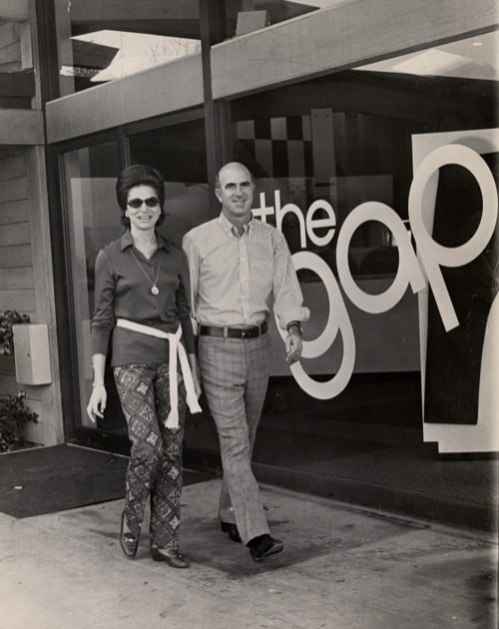
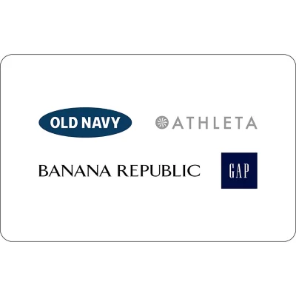
The Origins
1979
GAP goes Public
1994 GAP opens its
First Old Navy Store
Founded in 1969
1983
GAP Acquires

Slide 5
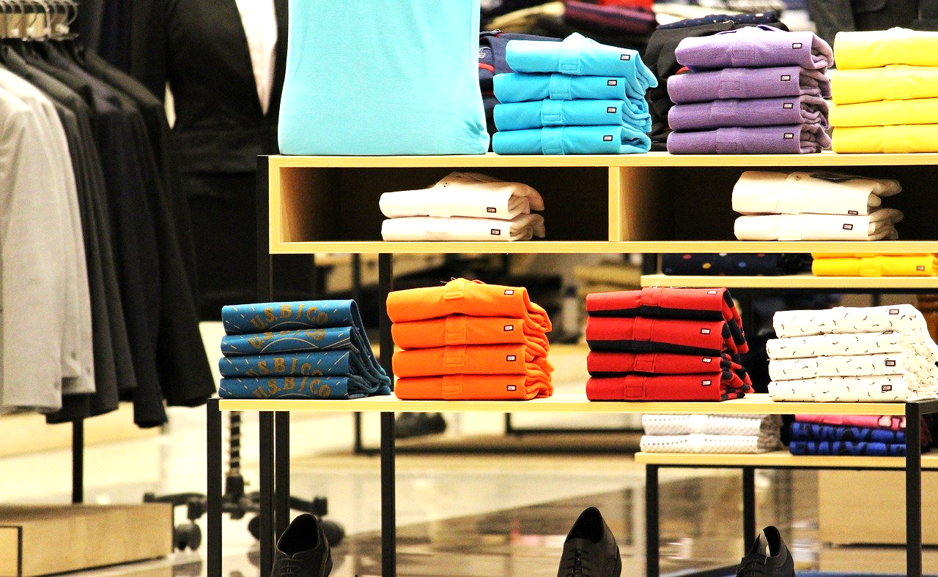
Business Case
Art Peck, CEO of GAP fired his creative directors in 2015 to decentralise the creative process & transition into big data business model.
In the following slides, our objective is to assess the appropriateness of Pecks' choice to terminate the creative directors. Furthermore, we will examine the significance of big data within the data-centric creative process and its broader role within the marketing team.

Slide 6
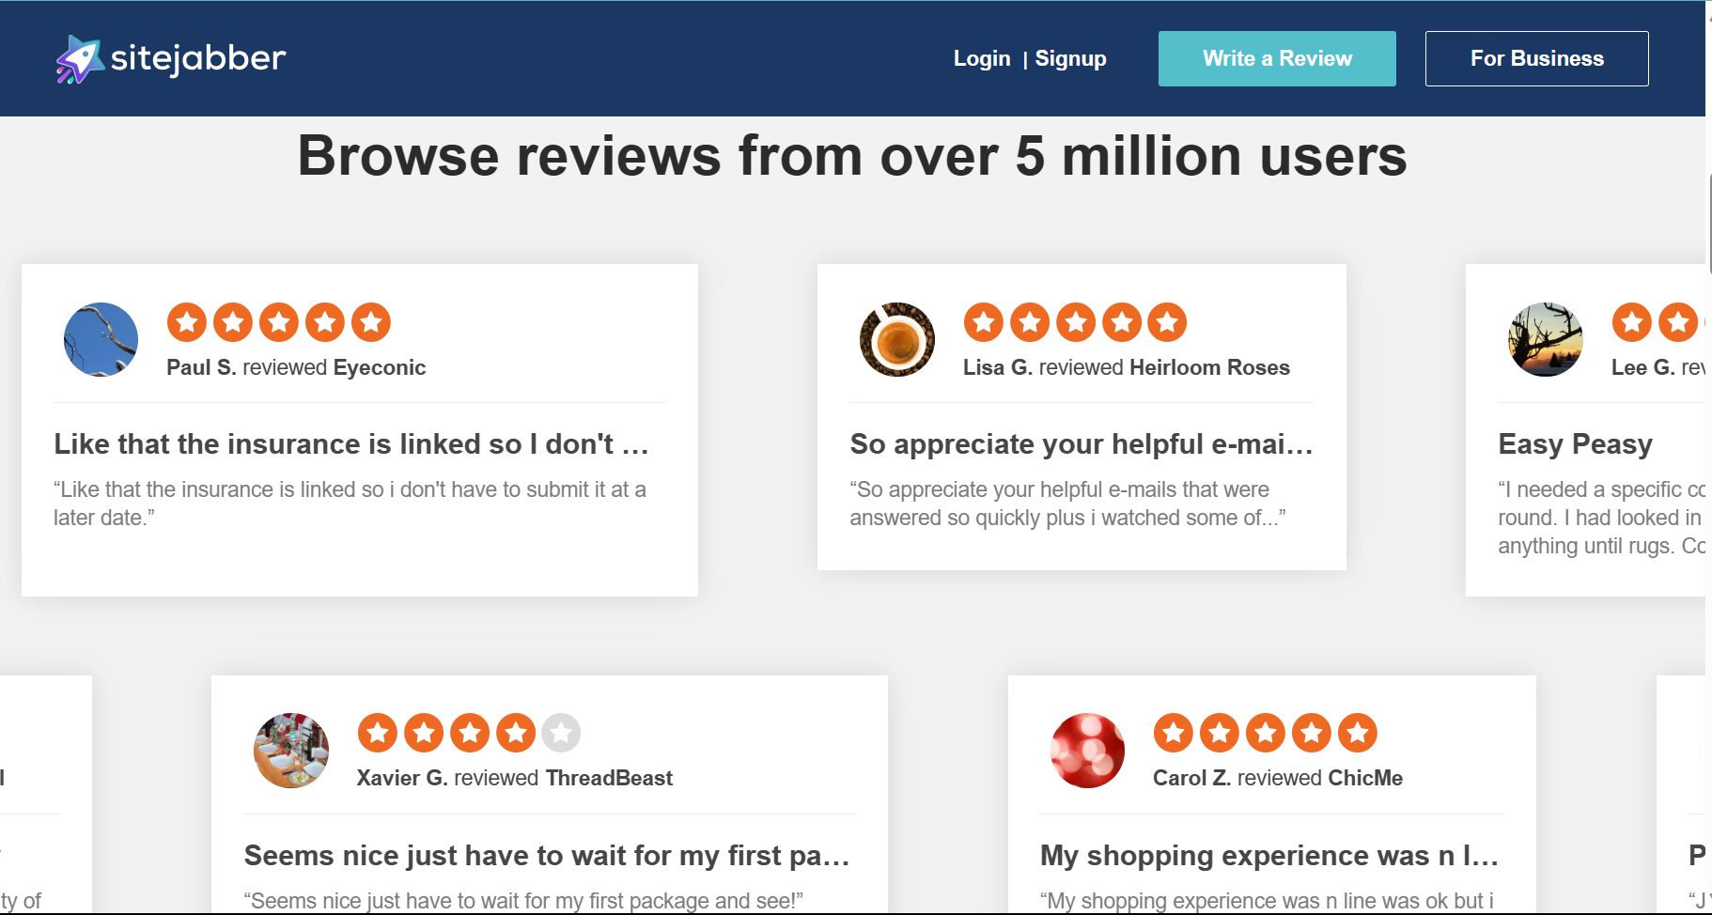
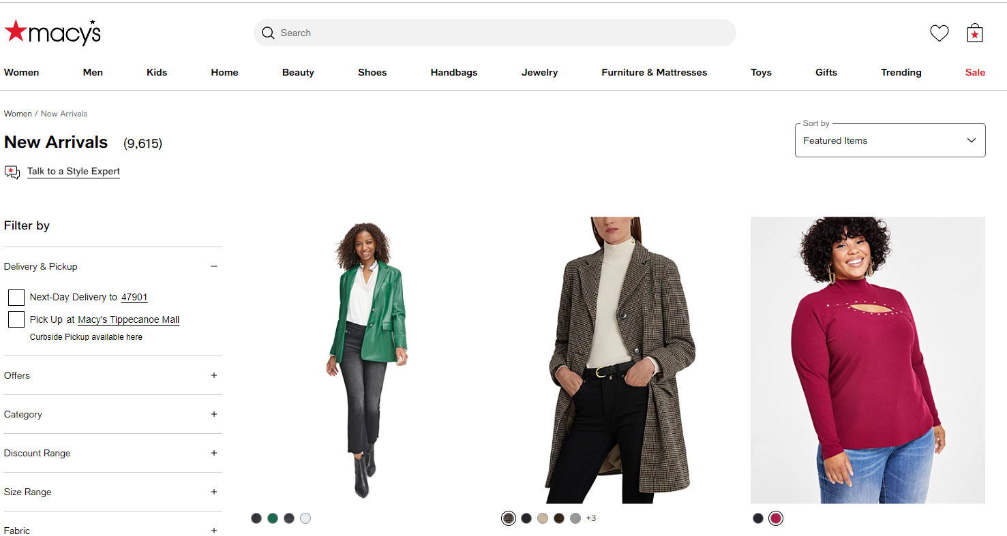
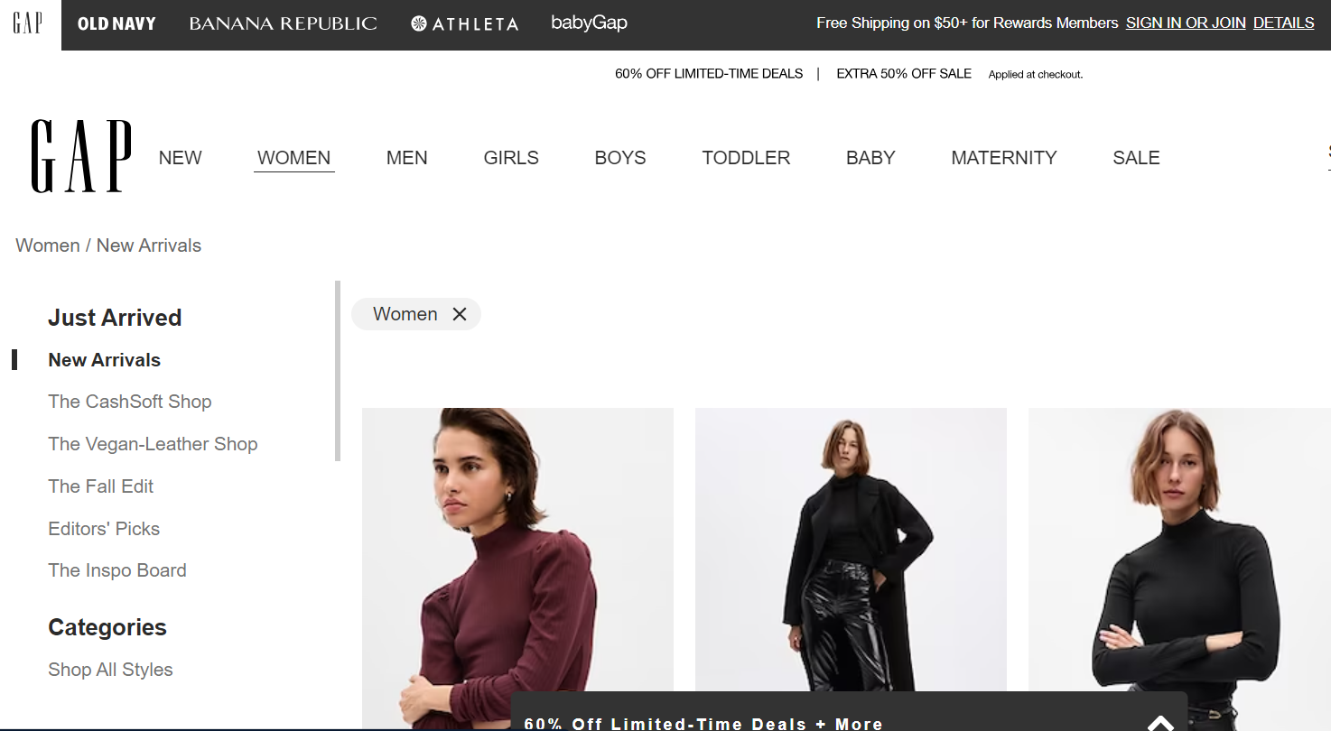
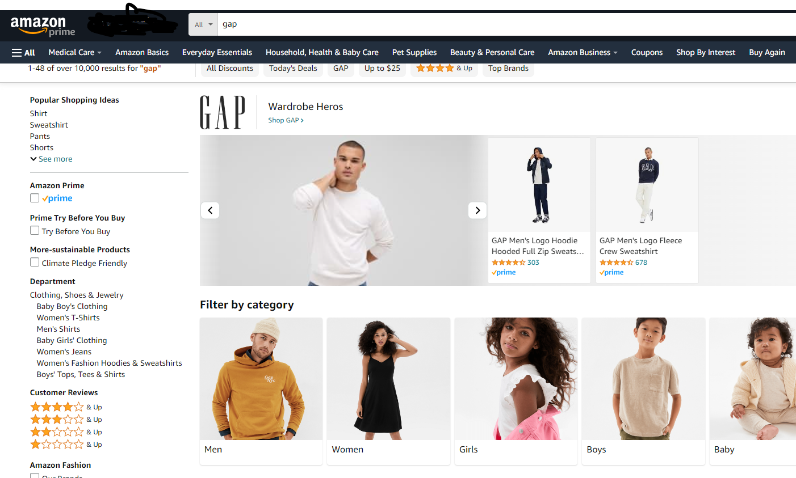
Data Sources

Slide 7
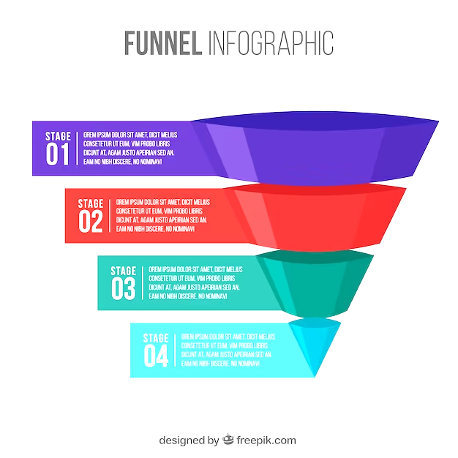
Process Flow:
Brand Landscape
Product-level Analysis
Product Portfolio Analysis

Slide 8

Brand Landscape:
Our first analysis involved data scraping from the website SiteJabber to obtain customer ratings across various dimensions for Gap Inc.'s brands as well as competitor brands. This approach was designed to assess how our brands perform in comparison to industry standards.

Slide 9
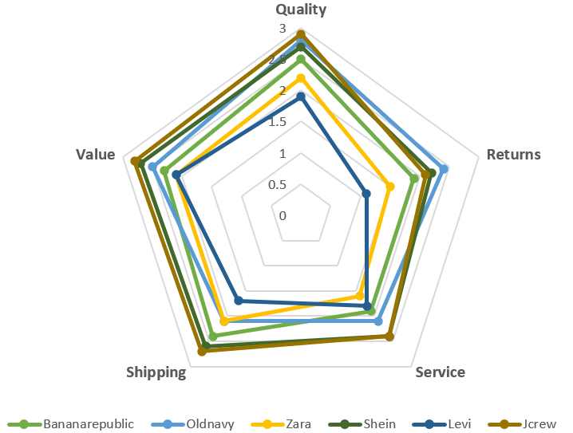
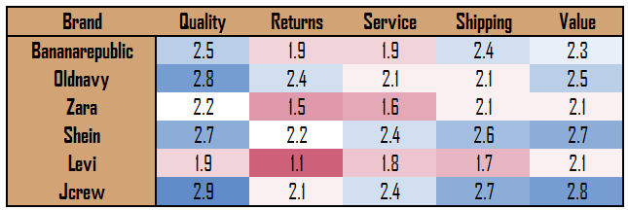
Insights Gathered:
Banana Republic should focus on returns & customer service to be able to compete with J.Crew, it’s direct competitor, to improve sales
Old Navy should also look into logistics & its services to improve customer satisfaction.
Additionally, Banana Republic could improve quality of its product, given that quality is its primary focus.

Slide 10

Product Level Analysis:
With our second analysis, we scrapped ratings of products of one category from Amazon and GAP website
The idea was to decipher if the product quality of GAP is at par with Amazon
A t-test was run on the sampled data analyzing the distribution of ratings from the two websites

Slide 11
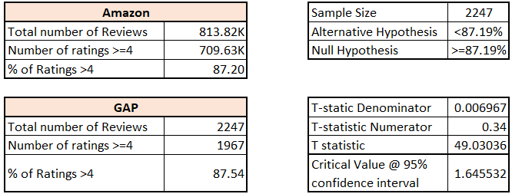
Analysis and Insights:
Ho : GAP is not doing better than Amazon
Ha : GAP doing better than Amazon,
Since t-value is greater than the critical value, we cannot reject null hypothesis; this means we don’t have evidence to conclude that GAP is doing better than the market. This requires a comprehensive dive into the company’s product portfolio.

Slide 12

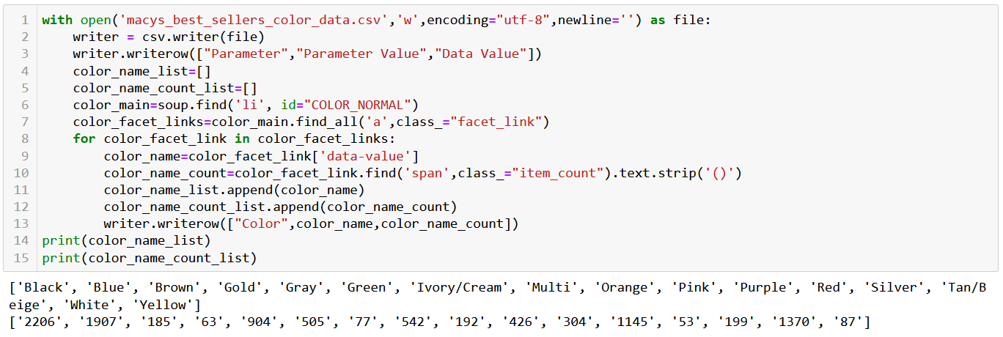
Product Portfolio Analysis:
For our third analysis, we gather quantitative information for from Macy’s official website to decipher the product portfolio and compare it with that for Old Navy.
Six product features were finalized to gauge the disparities by scraping data from both the websites.
Features considered: Neckline | Fabric | Sleeve Length | Color | Occasion | Price Range

Slide 13
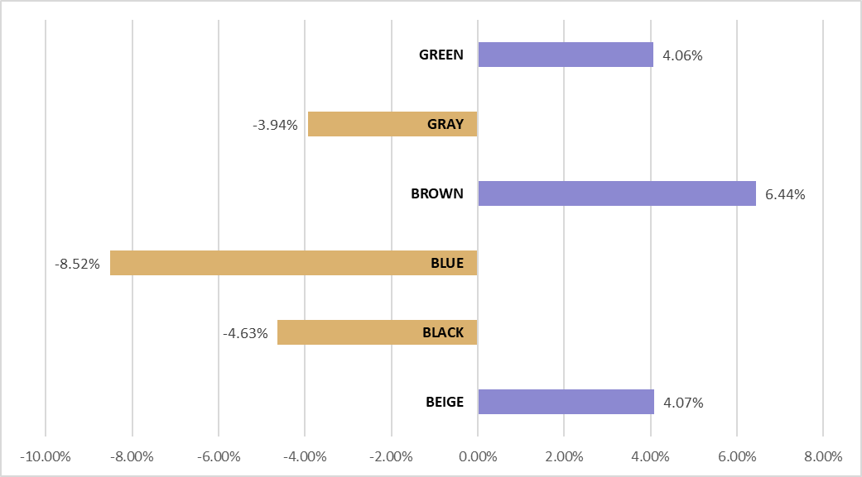
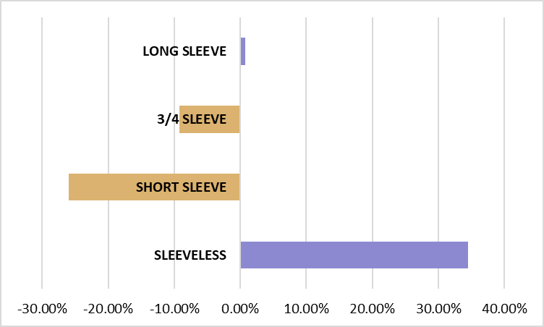
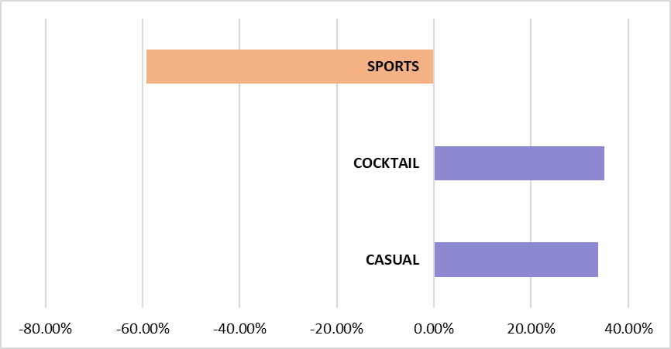
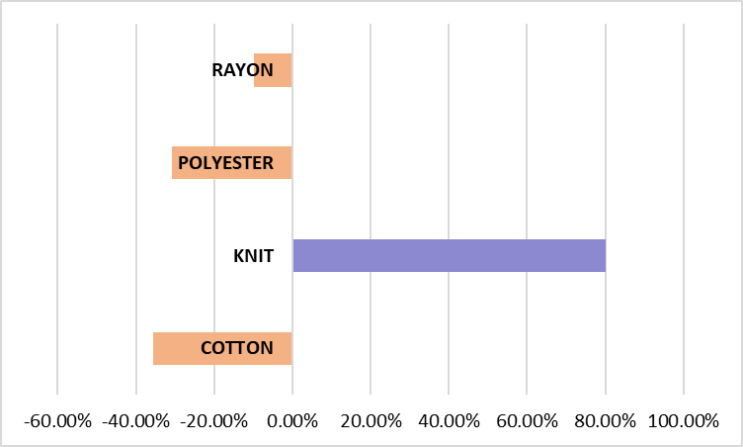
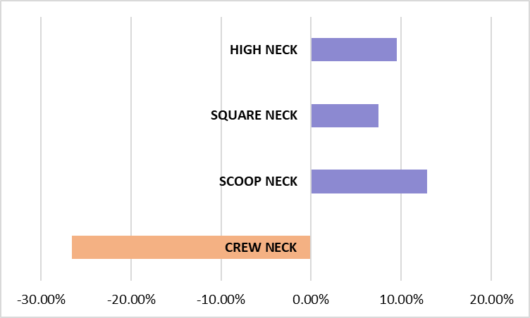
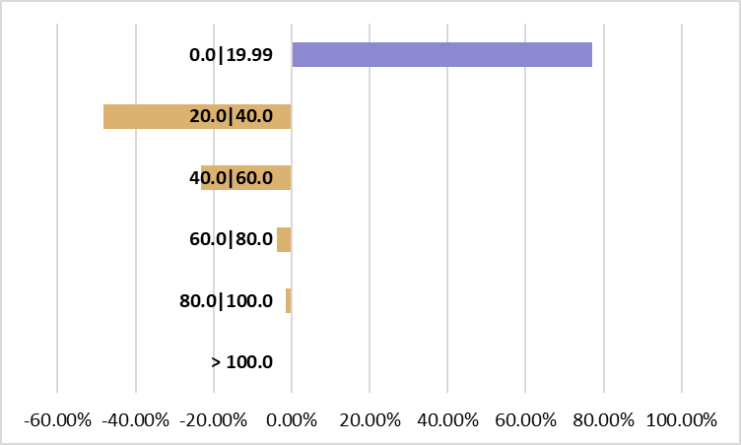
Product Features - Old Navy vs Macy’s
Color
Sleeve Length
Occasion
Sleeve
Fabric
Neckline
Price Range

Slide 14

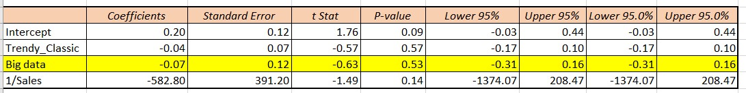
Influence of Big Data On Pricey Brands
It would be interesting to check if brands that focus more on apparel quality and rich designs consume as much data to make their design decisions.
We performed hypothesis testing for the percentage change in sales for such brands.
Independent factors considered for regression:
(1/Annual Sales) -> To account for size of the company
Classy/Trendy (Categorical variable) -> To incorporate the type of designs
Big Data (0/1) -> Prevalent usage of data for product design by the company today (Yes/No)

Slide 15

Conclusion
Old Navy
Relies on fast fashion and current trends
Data can inform marketing and pricing strategies effectively
Big data approach is better served
GAP
Offers a mix of basics and fashion-forward items
Data can be useful for basics, it may struggle to drive innovation for fashion-forward items
Effectiveness of big data approach is moderate
Banana Republic
Known for its quality and classy designs
Data-driven approaches may hinder its ability to create unique and innovative fashion
Big data is less suited

Slide 16
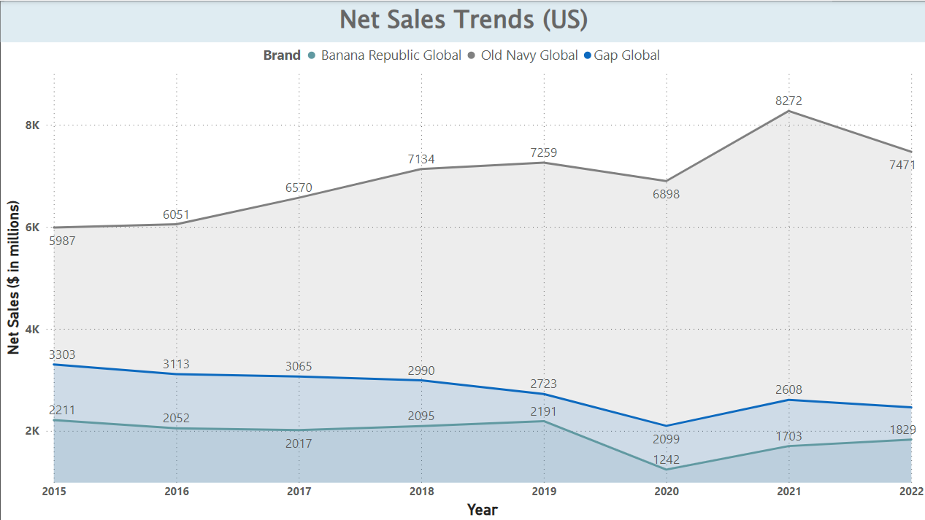

Slide 17

Recommendations:
Recommendations:
To cater to GenZ crowd, GAP and Old Navy should leverage influencer marketing like Zara and Shein do in the form of “try on hauls”. These are extremely popular on social media and has 2 sided advantages: Reduced marketing cost and higher conversion rate.
Focus more on timing of digital marketing like advertise more when prices of competitors go up , to take advantage of price sensitive crowd.

Slide 18

Limitations
Data Scraping Challenges: web scraping may face occasional challenges as the websites change their underlying structure.
Our analysis is based on ratings form sites, so we have considered their underlying rating algorithm to be fair and non tampered.

Slide 19

Thank You

Slide 20

Questions ?

